Slide 1
I spend too much effort in referencing my writings, I wish I have a solution 😟
Adam Sandler

Slide 2

Text Classification
NLP
[AbdelMageed Ahmed AbdelMageed Hassan]
[Mohamed Sayed AbdelWahab Hussien]
[Sarah Hossam AbdelHameed Elmowafy]
[Ahmed Shehata Mahmoud AboMooustafa]
Notes:
<a href='https://www.freepik.com/vectors/people'>People vector created by pch.vector - www.freepik.com</a>

Slide 3
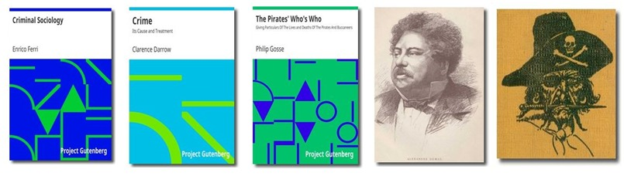
Crime Books

Slide 4

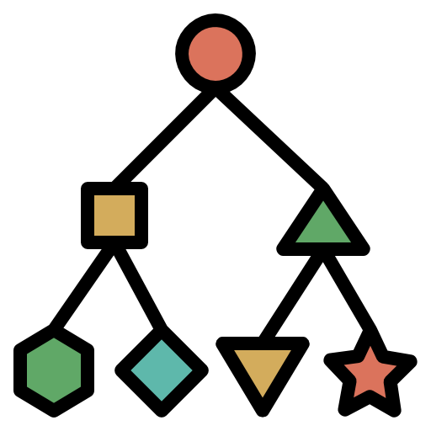

Steps
1
2
3
4
Data Preparation
Text Transformation
Classification
Evaluation & Error Analysis
“Input garbage output garbage” that’s why data need to be prepared to have a good output
For machine learning models, the textual data must be converted to numeric data. Just to be able to apply next steps like classification
Out of many classifiers, the proper one that fits the data needs to be selected to correctly predict any given new data.
Evaluation and Error analysis provides automatic tools to help break down the model’s errors into meaningful groups.

Slide 5



Data Preparation
Data Pre-processing
Converting to lower case
Data Partitioning
L
l
Stop words removal
Lemmatization
Data Labeling

Slide 6
Text Transformation
1
2
Vocabulary of known words
Measure of the presence of know words.
1
2
We compute a score for each word to signify its importance in the document and corpus
Bag of Words
TF-IDF
We used it because it preserves the meaning of words and sentences In our model
we used unigram and bigram.
Word embedding
Is a type of word representation that allows words with similar meaning to have a similar representation.
N-Grams
3
4
4
3

Slide 7

classification
SVM
KNN
2
3
We used support vector machines and it yields high accuracy with different transformations
K Nearest neighbor also gives high accuracies with BoW specially and the other transformations
Decision Trees
Neural Networks
Decision Trees used to give lower accuracies in this model with all the transformations
For word Embedding, we built our deep neural with network and trained with our text data using embedding layer.
1
4
Notes:
<a href='https://www.freepik.com/vectors/business'>Business vector created by pikisuperstar - www.freepik.com</a>

Slide 8
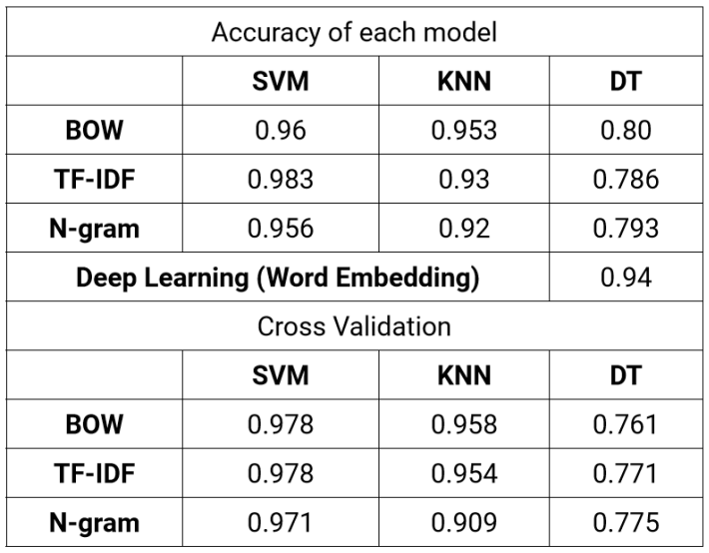



Slide 9
Champion Model
SVM based on TF-IDF
KNN based on TF-IDF
DT based on N-Grams
SVM based on BoW
KNN based on N-Grams

Slide 10
SVM with TF-IDF
Default parameters are used, just change kernel to 'sigmoid' o Testing accuracy is 0.986 o cross validation accuracy is 0.98
When we change the kernel to poly and the max_iter from -1 to 3 the model accuracy decreased to 0.76
o using kernel poly instead of sigmoid, which is more generalized representation of the linear kernel. It is less efficient and accurate.
o setting Max_iter to 3 to limit the number of model iteration

Slide 11
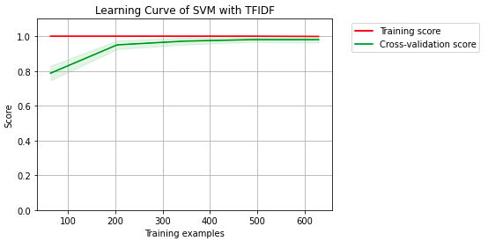

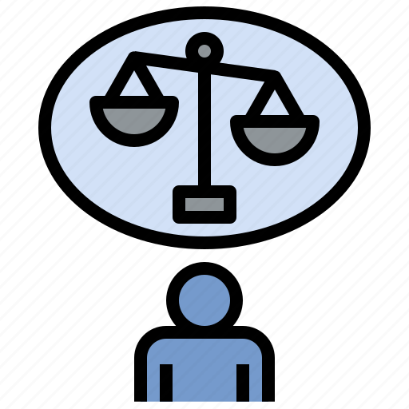


Model Evaluation
1
2
Cross-Validation
Bias
Applying ten-fold cross validation to the champion model gives average accuracy 0.982 and 100% accuracy in the training set and testing accuracy of 0.976
SVM Based on TF_IDF model have low average bias by using mlxtend.evaluate.bias_variance_decomp module we get average bias 0.043
Learning curve
Variability
to get an estimate of model’s generalization performance is Learning Curves
SVM Based on TF_IDF model have low average variance, our module got average bias 0.015
4
3

Slide 12
Error analysis of champion model
SVM based on TF_IDF misclassifies only 4 documents out of 300 documents in the testing set.
It misclassifies Two documents of label C as E and B, One document of label E as C, and one document of label B as D.
These documents have common words in the actual and the predicted books , So the model classifies them to the class that has a higher number of words in common with that document.
as the model had trained on TF_IDF, it doesn’t understand that the sequence of sme words or sentences is related to a specific class.

Slide 13
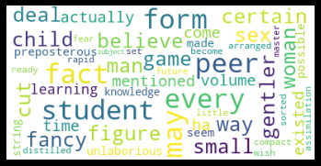

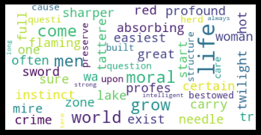
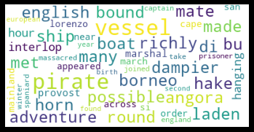

Error Analysis
Document that misclassified
Word
Cloud
Predicted class
Actual class

Slide 14
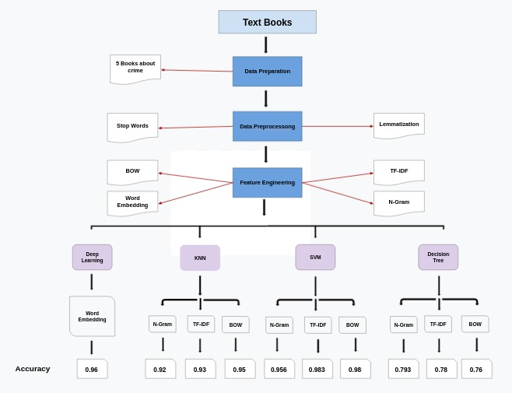
Conclusion

Slide 15

THANK YOU
Any questions?
Notes:
<a href='https://www.freepik.com/vectors/business'>Business vector created by pch.vector - www.freepik.com</a>

